Slide 1
CHAPTER 6:
Normalization
DCI3023 – DATABASE
DCI2033 – DATABASE SYSTEM

Slide 2
Learning Outcomes
Student should be able to:
  Appreciate the importance of normalization process in designing database.
  Identify functional dependencies between attributes in a relation.
  Reorganize various problems due to redundant data and update anomalies.
  Identify features of each Normal Form and then undertake the process of normalization from 1NF to BCNF.
  Understand the concept of multi valued dependency, join dependency and lossless decomposition.

Slide 3
Introduction
Normalization
  Process for evaluating and correcting table structures to minimize data redundancies
    Reduces data anomalies
  Works through a series of stages called normal forms:
    First normal form (1NF)
    Second normal form (2NF)
    Third normal form (3NF)

Slide 4
Introduction
  2NF is better than 1NF; 3NF is better than 2NF
  For most business database design purposes, 3NF is as high as needed in normalization
  Highest level of normalization is not always most desirable
Denormalization produces a lower normal form
  Price paid for increased performance is greater data redundancy

Slide 5
Purpose of Normalization
easier for the user to access and maintain the data
take up minimal storage space on the computer

Slide 6
The Need for Normalization
Example: company that manages building projects
  Charges its clients by billing hours spent on each contract
  Hourly billing rate is dependent on employee’s position
  Periodically, report is generated that contains information such as displayed in Table 5.1

Slide 7


Slide 8
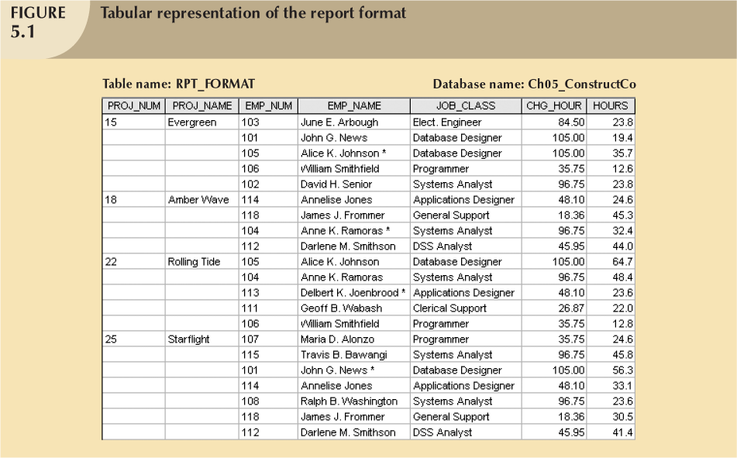
The assignment of employees to projects

Slide 9
Figure 5.1 Discussion
The table entries invite data inconsistencies
  E.g.: the JOB_CLASS value “Elect. Engineering” might be entered as “Elect. Eng.” or “El. Eng.” or “EE”
Display data redundancies
  Update anomalies
    Modifying the JOB_CLASS for employee number 105 requires may alterations, one for each EMP_NUM = 105.
    E.g.: Database Designer change to Systems Analyst with CHG_HOUR value 96.75

Slide 10
Figure 5.1 Discussion
Display data redundancies
  Insertion anomalies :: to complete a row definition, a new employee must be assigned to a project
  Deletion anomalies ::
    One employee is associated with a given project
    If the employee leaves the company and the employee data are deleted, the project information will also be deleted.

Slide 11
The assignment of employees to projects

Slide 12
Figure 5.1 Discussion
Display data redundancies
  Update
    Darlene M. Smithson is assigned to the new work project on the Evergreen project
    15 Evergreen 112 Darlene M. Smithson DSS Analyst $45.95 0.0
    How about when 200 or 300 table entries must be made?
    Wasted disk space
    Data integrity problems
    15 Evergeen 112 Darlean Smithson DDS Analyst $45.95 0.0

Slide 13
Data Redundancy and Update Anomalies (Example #2)
Problems associated with data redundancy are illustrated by comparing the Staff and Branch relations with the StaffBranch relation.
© Pearson Education Limited 1995, 2005

Slide 14


Data Redundancy and Update Anomalies

Slide 15
Data Redundancy and Update Anomalies
StaffBranch relation has redundant data; the details of a branch are repeated for every member of staff.
In contrast, the branch information appears only once for each branch in the Branch relation and only the branch number (branchNo) is repeated in the Staff relation, to represent where each member of staff is located.
© Pearson Education Limited 1995, 2005

Slide 16
Data Redundancy and Update Anomalies – Insertion Anomalies
2 types of insertion anomalies:
  To insert the details of new members of staff into the StaffBranch relation
    Must include the details of the branch at which the staff are to be located
  To insert details of new branch that currently has no members of staff into the StaffBranch relation
    Necessary to enter nulls into attributes for staff (staffNo), however staffNo is primary key and not allowed to be null

Slide 17
Data Redundancy and Update Anomalies

Slide 18
Data redundancy and Update Anomalies – Delete Anomalies
Delete a row from the StaffBranch relation (SL41), the details about the branch are also lost

Slide 19
Data redundancy and Update Anomalies – Delete Anomalies (2)
Branch row stored separately from staff tuples and only the attribute branchNo relates the two relation
If the staff number SA9 delete from the Staff relation, the details on branch number B007 remain unaffected in Branch relation

Slide 20
Data redundancy and Update Anomalies – Modification Anomalies
change the value of one of the attributes of a particular branch in the StaffBranch relation, e.g. the address of branch number B005
  need to update the rows of all staff located at that branch

Slide 21
Data redundancy and Update Anomalies – Modification Anomalies
Cont..
  If the modification is not carried out on all the appropriate rows of StaffBranch relation
    database will become inconsistent

Slide 22
Normalization Process
DCI3023 – DATABASE
DCI2033 – DATABASE SYSTEM

Slide 23
Well-formed table characteristics
Each table represents a single subject
No data item will be unnecessarily stored in more than one table
All attributes in a table are dependent on the primary key
Each table void of insertion, update, deletion anomalies

Slide 24
Unnormalized Form (UNF)
A table that contains one or more repeating groups.
To create an unnormalized table
  Transform the data from the information source (e.g. form) into table format with columns and rows.

Slide 25
Conversion to First Normal Form
First normal form describes tabular format in which:
  All key attributes are defined
  There are no repeating groups in the table
  All attributes are dependent on primary key
Some tables contain partial dependencies
  Dependencies based on part of the primary key

Slide 26
Conversion to First Normal Form (2)
Step 1: Eliminate the Repeating Groups
  Eliminate nulls: each repeating group attribute contains an appropriate data value
Step 2: Identify the Primary Key
  Must uniquely identify attribute value
  New key must be composed
Step 3: Identify All Dependencies
  Dependencies depicted with a diagram

Slide 27
Initial Representation

Slide 28
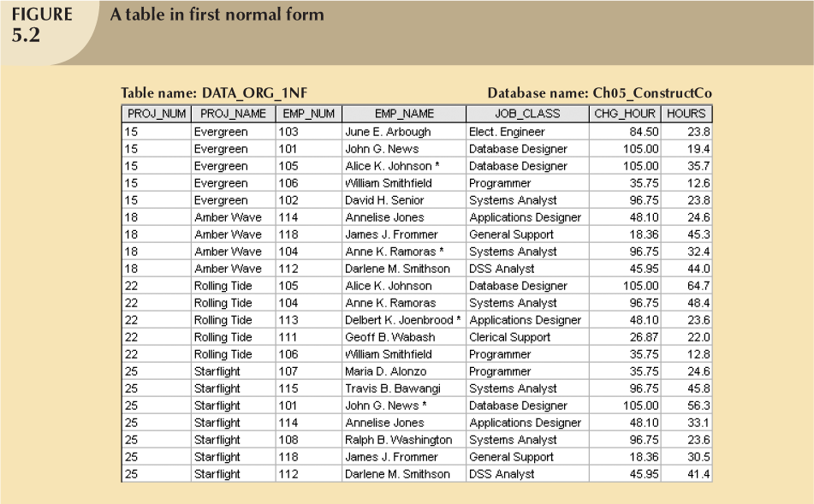
1st Normal Form Representation

Slide 29
Conversion to First Normal Form (5)
Step 2: Identify the Primary Key
  Must uniquely identify attribute value
  New key must be composed
    Is PROJ_NUM is an adequate primary key?
    E.g.: PROJ_NUM value 15 can identify any one of the 5 employees
  Uniquely identify
    PROJ_NUM and EMP_NUM

Slide 30
1st Normal Form Representation

Slide 31
Conversion to First Normal Form (6)
Step 3: Identify All Dependencies
  Dependencies depicted with a diagram

Slide 32
Functional Dependency
DCI3023 – DATABASE
DCI2033 – DATABASE SYSTEM

Slide 33
Introduction
Determination
  If you know the value of attribute A, you can determine the value of attribute B
Functional Dependency
  if A and B are attributes of relation R, B is functionally dependent on A (denoted A → B) if A determines B
  The attribute B is functionally dependent on the attribute A if each value in column A determines one and only one value in column B

Slide 34
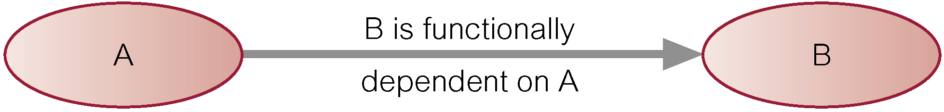
Introduction
Functional Dependency (cont..)
  Diagrammatic representation
  The determinant of a functional dependency refers to the attribute or group of attributes on the left-hand side of the arrow.

Slide 35
Introduction
Functional Dependency (cont..)
  E.g.:
  StuNum → StuName, StuSurname
StuNum | StuName | StuSurname
CC06031 | Afiq | Zakaria
CC06049 | Afiq | Abdullah
StuName and StuSurname is functionally dependent on StuNum
Determinant

Slide 36
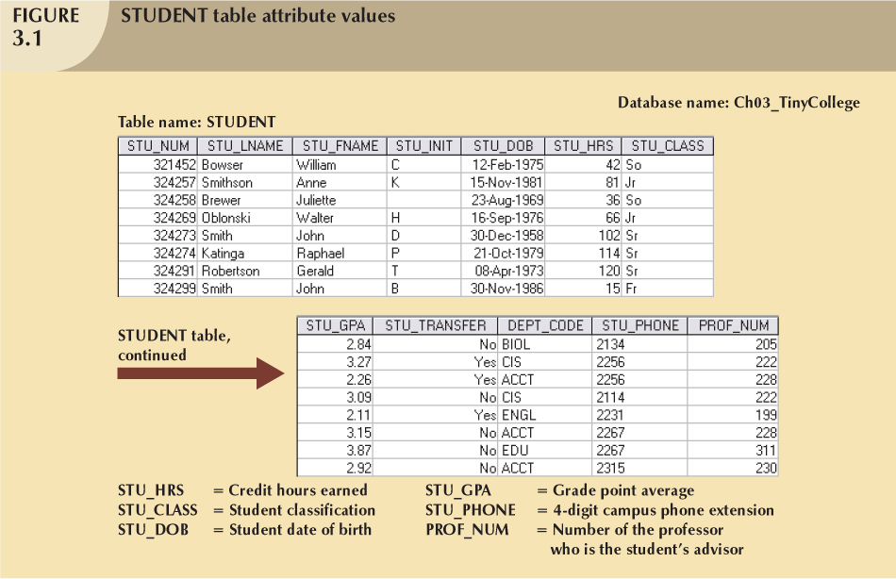

Slide 37
Introduction
Example
  STU_PHONE is functionally dependent on STU_NUM
    STU_NUM value 321452 determines the STU_PHONE value 2134
  STU_NUM is not functionally dependent on STU_PHONE
    STU_PHONE value 2267 is associated with two STU_NUM value: 324274 and 324291

Slide 38
Functional Dependency with more than one attribute (composite key)
Full Functional Dependency
  If the attribute (B) is functionally dependent on a composite key (A) but not on any subset of that composite key, the attribute (B) is fully functionally dependent on (A).
  Example:
    STU_NUM, CRS_CODE → GRADE
STU_NUM | CRS_CODE | GRADE
CC0660 | DCI3023 | A
CC0699 | DCN3043 | B+

Slide 39
Functional Dependency with more than one attribute (composite key)
Cont..
  STU_NUM, CRS_CODE → CRS_NAME
  CRS_NAME is also functionally dependent on a subset of (STU_NUM, CRS_CODE), namely CRS_CODE. Example above is a partial dependency.

Slide 40
Functional Dependency
Main characteristics of functional dependencies used in normalization:
  There is a one-to-one relationship between the attribute(s) on the left-hand side (determinant) and those on the right-hand side of a functional dependency.
  Holds for all time. (e.g.: StuNum → StuName)
  The determinant has the minimal number of attributes necessary to maintain the dependency with the attribute(s) on the right hand-side.

Slide 41
Transitive Dependency
describes a condition where A, B, and C are attributes of a relation such that if A → B and B → C, then C is transitively dependent on A via B (provided that A is not functionally dependent on B or C)
Example:
  EMP_NUM (A), JOB_CLASS (B), CHG_HOUR (C)
    EMP_NUM → JOB_CLASS
    JOB_CLASS → CHG_HOUR

Slide 42
Transitive Dependency

Slide 43
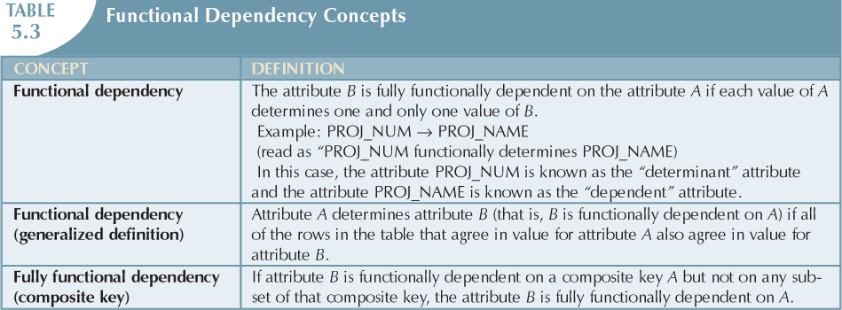
Summary of Functional Dependency Concepts

Slide 44
Conversion to First Normal Form
Step 3: Identify All Dependencies
  Dependencies depicted with a diagram

Slide 45
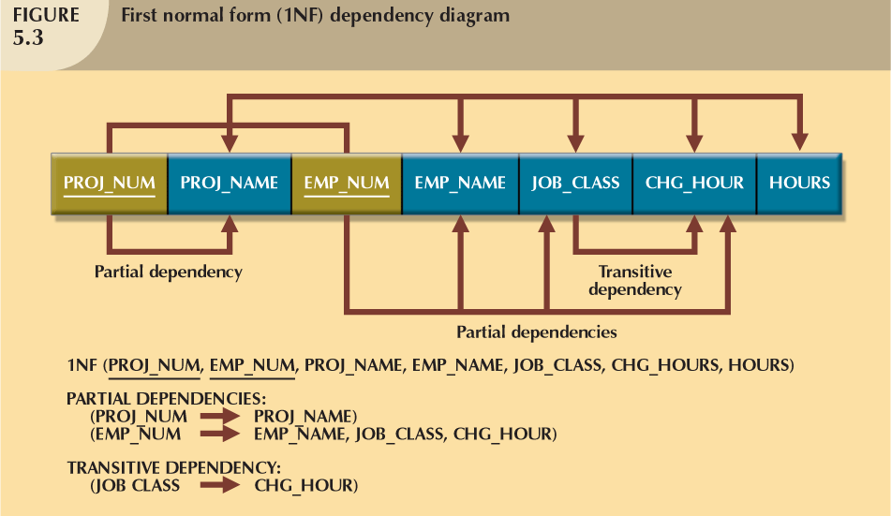
Conversion to First Normal Form

Slide 46
Conversion to First Normal Form
Step 3: Identify All Dependencies
  PROJ_NUM → PROJ_NAME (partial dependency)
  EMP_NUM → EMP_NAME, JOB_CLASS, CHG_HOUR (partial dependency)
  JOB_CLASS → CHG_HOUR (transitive dependency)
  PROJ_NUM, EMP_NUM → HOURS (primary key)

Slide 47
Conversion to First Normal Form
1NF
  PROJECT (PROJ_NUM, EMP_NUM, PROJ_NAME, EMP_NAME, JOB_CLASS, CHG_HOURS, HOURS)

Slide 48
Normalization Process- Second Normal Form
DCI3023 – DATABASE
DCI2033 – DATABASE SYSTEM

Slide 49
Conversion to Second Normal Form
Table is in second normal form (2NF) when:
  It is in 1NF and
  It includes no partial dependencies:
    No attribute is dependent on only portion of primary key

Slide 50
Dependency Diagram

Slide 51
Conversion to Second Normal Form
Step 1: Write Each Key Component
on a Separate Line
  Write each key component on separate line, then write original (composite) key on last line
  Each component will become key in new table
Step 2: Assign Corresponding Dependent Attributes
  Determine those attributes that are dependent on other attributes
  At this point, most anomalies have been eliminated

Slide 52
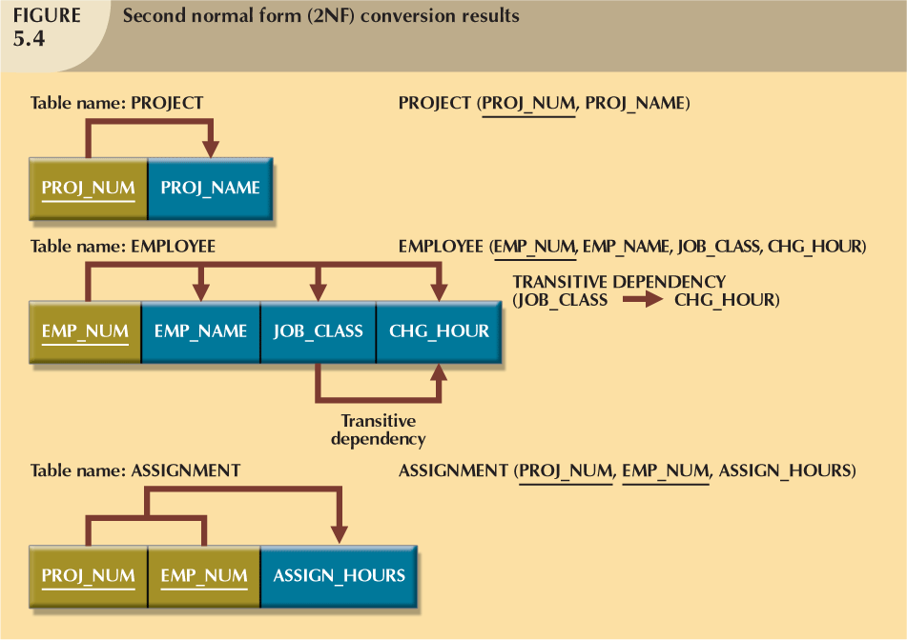
Conversion to Second Normal Form

Slide 53
Conversion to First Normal Form
1NF
  PROJECT (PROJ_NUM, EMP_NUM, PROJ_NAME, EMP_NAME, JOB_CLASS, CHG_HOURS, HOURS)

Slide 54
Conversion to First Normal Form
Step 3: Identify All Dependencies
  PROJ_NUM, EMP_NUM → HOURS (primary key)
  PROJ_NUM → PROJ_NAME (partial dependency)
  EMP_NUM → EMP_NAME, JOB_CLASS, CHG_HOUR (partial dependency)
  JOB_CLASS → CHG_HOUR (transitive dependency)

Slide 55
Conversion to Second Normal Form
1NF
  PROJECT (PROJ_NUM, EMP_NUM, PROJ_NAME, EMP_NAME, JOB_CLASS, CHG_HOURS, HOURS)
2NF
  PROJECT (PROJ_NUM, PROJ_NAME)
  EMPLOYEE (EMP_NUM, EMP_NAME, JOB_CLASS, CHG_HOURS)
  ASSIGNMENT (PROJ_NUM, EMP_NUM, HOURS)

Slide 56
Normalization Process- Third Normal Form
DCI3023 – DATABASE
DCI2033 – DATABASE SYSTEM

Slide 57
Conversion to Third Normal Form
A table is in third normal form (3NF) when both of the following are true:
  It is in 2NF
  It contains no transitive dependencies

Slide 58
Conversion to Third Normal Form
Step 1: Identify Each New Determinant
  For every transitive dependency, write its determinant as PK for new table
  Determinant: any attribute whose value determines other values within a row
Step 2: Identify the Dependent Attributes
  Identify attributes dependent on each determinant identified in Step 1
    Identify dependency
  Name table to reflect its contents and function

Slide 59
Conversion to Third Normal Form
Step 3: Remove the Dependent Attributes from Transitive Dependencies
  Eliminate all dependent attributes in transitive relationship (s) from each of the tables
  Draw new dependency diagram to show all tables defined in Steps 1–3
  Check new tables as well as tables modified in Step 3
    Each table has determinant
    No table contains inappropriate dependencies

Slide 60
Conversion to Second Normal Form
1NF
  PROJECT (PROJ_NUM, EMP_NUM, PROJ_NAME, EMP_NAME, JOB_CLASS, CHG_HOURS, HOURS)
2NF
  PROJECT (PROJ_NUM, PROJ_NAME)
  EMPLOYEE (EMP_NUM, EMP_NAME, JOB_CLASS, CHG_HOURS)
  ASSIGNMENT (PROJ_NUM, EMP_NUM, HOURS)

Slide 61
Conversion to First Normal Form
Step 3: Identify All Dependencies
  PROJ_NUM, EMP_NUM → HOURS (primary key)
  PROJ_NUM → PROJ_NAME (partial dependency)
  EMP_NUM → EMP_NAME, JOB_CLASS, CHG_HOUR (partial dependency)
  JOB_CLASS → CHG_HOUR (transitive dependency)

Slide 62
Conversion to First Normal Form
2NF
  EMPLOYEE (EMP_NUM, EMP_NAME, JOB_CLASS, CHG_HOURS)
3NF
  EMPLOYEE (EMP_NUM, EMP_NAME, JOB_CLASS)
Transitive Dependency
JOB
(JOB_CLASS ,
CHG_HOURS)
New Relation

Slide 63
Conversion to Third Normal Form
2NF
  PROJECT (PROJ_NUM, PROJ_NAME)
  EMPLOYEE (EMP_NUM, EMP_NAME, JOB_CLASS, CHG_HOURS)
  ASSIGNMENT (PROJ_NUM, EMP_NUM, HOURS)
3NF
  ASSIGNMENT (PROJ_NUM, EMP_NUM, HOURS)
  PROJECT (PROJ_NUM, PROJ_NAME)
  EMPLOYEE (EMP_NUM, EMP_NAME, JOB_CLASS)
  JOB (JOB_CLASS, CHG_HOURS)

Slide 64
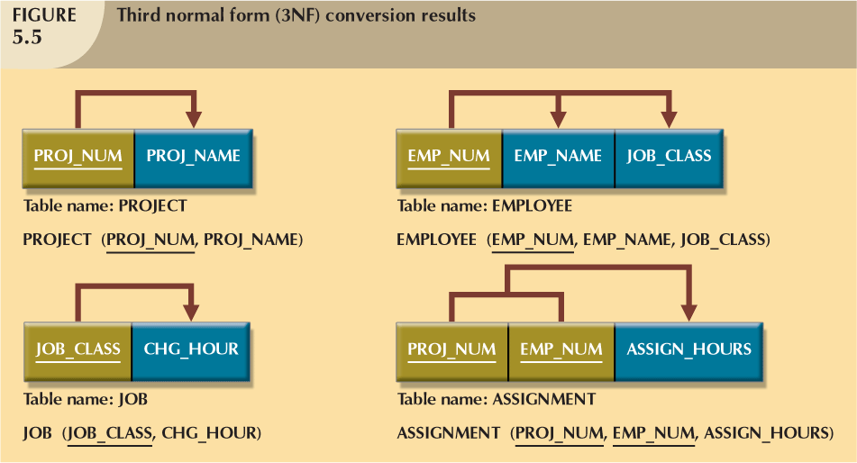
Conversion to Third Normal Form

Slide 65
Higher-Level Normal Forms
Tables in 3NF perform suitably in business transactional databases
Higher order normal forms useful on occasion
Two special cases of 3NF:
  Boyce-Codd normal form (BCNF)
  Fourth normal form (4NF)

Slide 66
The Boyce-Codd Normal Form (BCNF)
Every determinant in table is a candidate key
  Has same characteristics as primary key, but for some reason, not chosen to be primary key
When table contains only one candidate key, the 3NF and the BCNF are equivalent
BCNF can be violated only when table contains more than one candidate key

Slide 67
The Boyce-Codd Normal Form (BCNF)
Most designers consider the BCNF as special case of 3NF
Table is in 3NF when it is in 2NF and there are no transitive dependencies
Table can be in 3NF and fail to meet BCNF
  No partial dependencies, nor does it contain transitive dependencies
  A nonkey attribute is the determinant of a key attribute

Slide 68
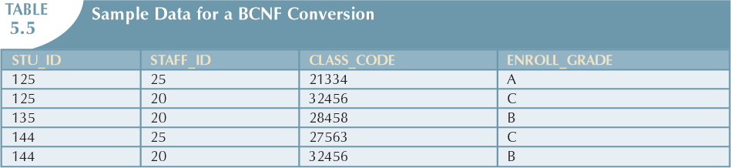
The Boyce-Codd Normal Form (BCNF)

Slide 69
Fourth Normal Form (4NF)
Table is in fourth normal form (4NF) when both of the following are true:
  It is in 3NF
  No multiple sets of multivalued dependencies
4NF is largely academic if tables conform to following two rules:
  All attributes dependent on primary key, independent of each other
  No row contains two or more multivalued facts about an entity

Slide 70
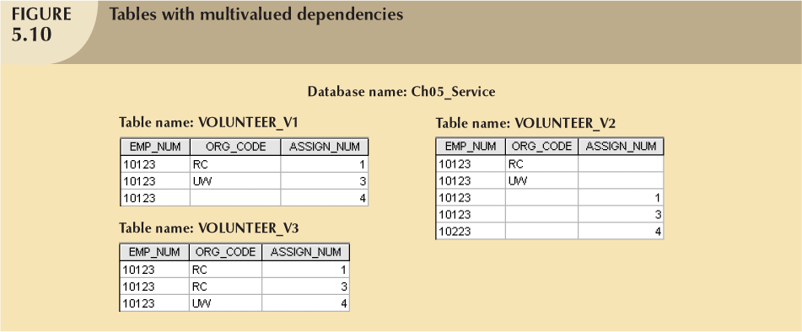
Fourth Normal Form (4NF)

Slide 71
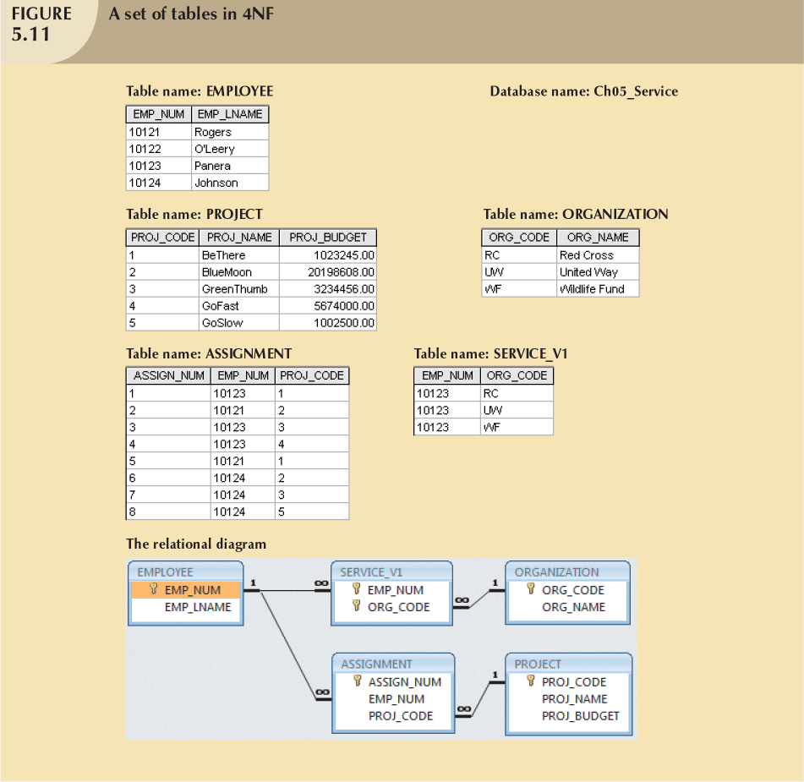

Slide 72
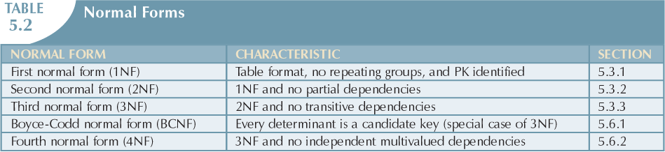
Conclusion of Normalization Process

Slide 73
Normalization and Database Design
ER diagram
  Identify relevant entities, their attributes, and their relationships
  Identify additional entities and attributes
Normalization procedures
  Focus on characteristics of specific entities
  Micro view of entities within ER diagram
Difficult to separate normalization process from ER modeling process

Slide 74
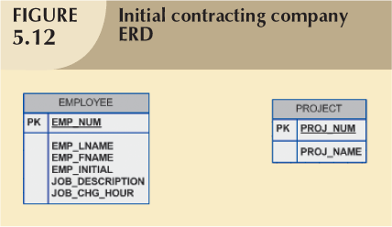
Normalization and Database Design

Slide 75
Normalized
3NF
  ASSIGNMENT (PROJ_NUM, EMP_NUM, HOURS)
  PROJECT (PROJ_NUM, PROJ_NAME)
  EMPLOYEE (EMP_NUM, EMP_NAME, JOB_CLASS)
  JOB (JOB_CLASS, CHG_HOURS)

Slide 76
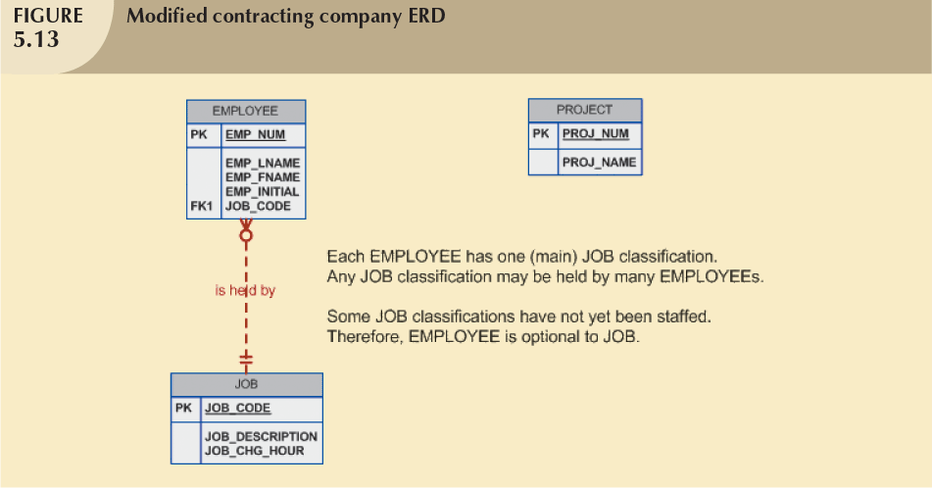

Slide 77
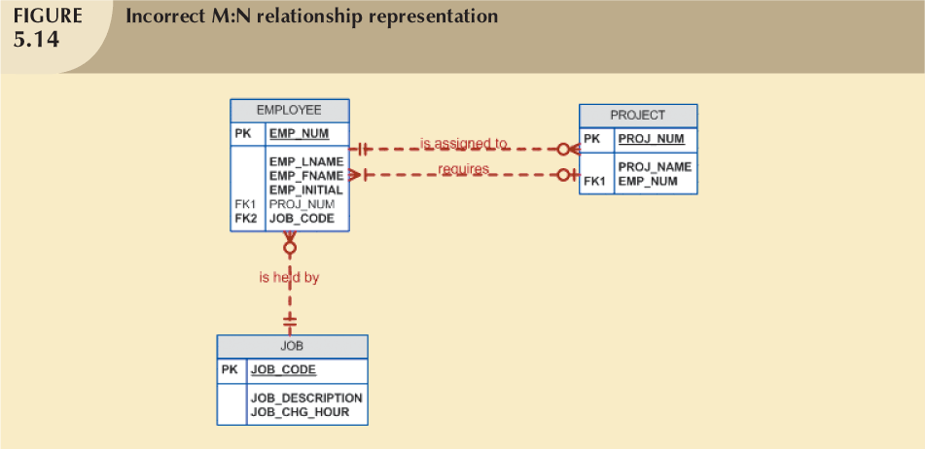

Slide 78
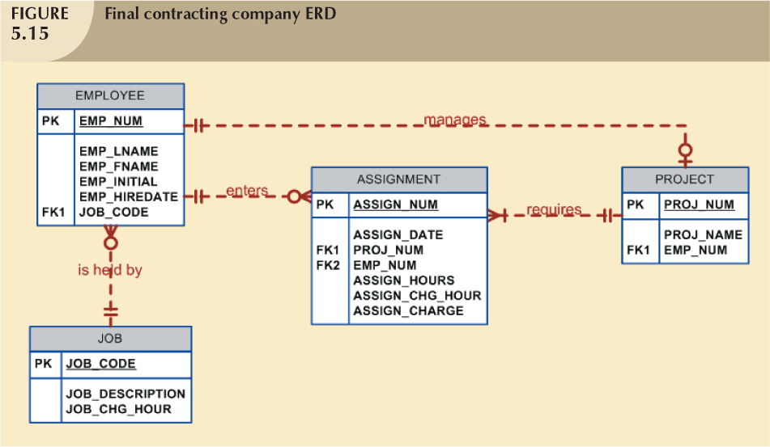

Slide 79
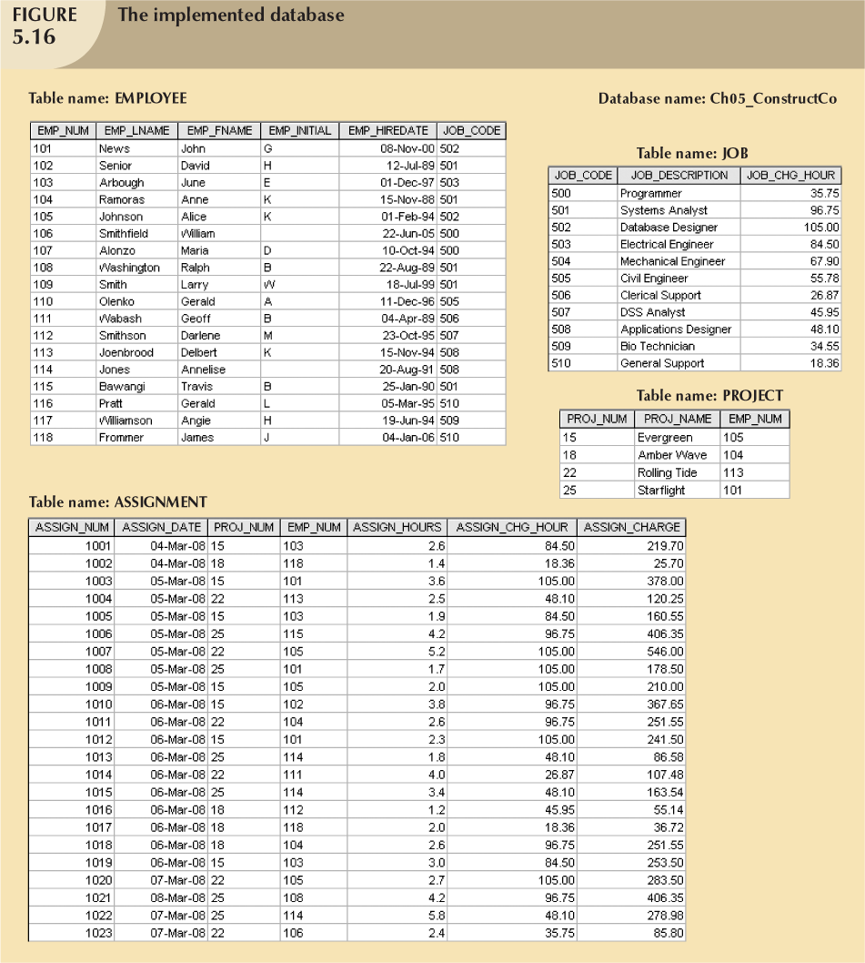

Slide 80
Denormalization
Creation of normalized relations is important database design goal
Processing requirements should also be a goal
If tables decomposed to conform to normalization requirements:
  Number of database tables expands

Slide 81
Denormalization
Joining the larger number of tables reduces system speed
Conflicts often resolved through compromises that may include denormalization
Defects of unnormalized tables:
  Data updates are less efficient because tables are larger
  Indexing is more cumbersome
  No simple strategies for creating virtual tables known as views

Slide 82
Denormalization
the process of attempting to optimize the performance of a database by adding redundant data or by grouping data. In some cases, denormalization helps cover up the inefficiencies inherent in relational database software (wikipedia)

Slide 83

Important…
Normalization is used to minimize data redundancies
First three normal forms (1NF, 2NF, and 3NF) are most commonly encountered
Table is in 1NF when:
  All key attributes are defined
  All remaining attributes are dependent on primary key

Slide 84
Important…
Table is in 2NF when
  it is in 1NF and
  contains no partial dependencies
Table is in 3NF when
  it is in 2NF and
  contains no transitive dependencies
Table that is not in 3NF may be split into new tables until all of the tables meet 3NF requirements

Slide 85
Important…
Normalization is important part—but only part—of the design process
Table in 3NF may contain multivalued dependencies
  Numerous null values or redundant data
Convert 3NF table to 4NF by:
  Splitting table to remove multivalued dependencies
Tables are sometimes denormalized to yield less I/O, which increases processing speed

